Slide 1



Predicting Team Wins in Basketball Using Statistical Models
A Data-Driven Approach to Understanding Team Performance
Sarthak Sunil Dhanke
15 Dec 2024

Slide 2
1. Unlocking the secrets to team success
2. Building a Robust Model to Predict Team Wins
3. From raw variables to effective predictors
Contents
4. Choosing the Right Outcome Variables
5. Checking Assumptions and Modelling
6. Future Work

Slide 3
Unlocking the Secrets to Team Success
Understanding the factors that influence a team’s performance can be challenging, but it's key to identifying what drives success.
By analyzing historical data, we can use predictive models to forecast wins, offering valuable insights into team strategies.
This approach allows for more informed decisions on resource allocation, player management, and overall team performance improvement.

Slide 4
Building a Robust Model to Predict Team Wins
Our approach starts with collecting comprehensive historical data, focusing on key performance metrics like offensive/defensive ratings, pace, and shooting efficiency.
We preprocess and clean the data to ensure accuracy, followed by feature selection to focus on the most impactful variables.
The final step is developing a predictive model that can accurately estimate the number of wins a team will achieve in a given season.

Slide 5
From Raw Variables to Predictors
Selecting Variables
Adding Variables
Adjusting Variables
Exclude Outcome-Driven Metrics: Remove predictors that directly depend on wins (e.g., playoffs, pts_per_game) to prevent data leakage.
Multicollinearity: Avoid using multiple highly correlated variables like fg_percent and ts_percent. (13 columns excluded)
Include Performance and Efficiency Metrics: Select variables that reflect team efficiency (offensive/defensive ratings) and playstyle (pace).
Test Variable Relationships: Pearson correlation and VIF to identify the most predictive variables for wins.
Win Percentage (win_percent): Calculate the proportion of wins relative to total games played by dividing wins by total games (wins + losses).
This normalized metric improves model stability and interpretability.
Adjusted Net Rating (adj_n_rtg): Modify the existing net rating by multiplying it with the strength of schedule (sos).
This adjustment provides a better understanding of a team's actual competitive standing.

Slide 6
Choosing the Right Outcome Variable
Content:
Linear Regression Over Poisson Regression:
Wins approximate a Gaussian distribution, making linear regression more suitable.
Poisson regression is designed for positively skewed count data, which doesn't align with our outcome variable.
Outcome Variable Options:
Total Wins (win):
Direct measure of success with simple interpretability.
Limitations: Skewed results for teams with more games played.
Win Percentage (win_percent):
Normalized measure for fair comparisons across teams.
Limitations: Less direct interpretability of predictor impacts.
Final Choice: win_percent
Ensures comparability across teams with varying game schedules.
Provides a robust relative measure, aligning with our goal to compare performance across teams.

Slide 7
Checking Assumptions
Homoscedasticity | Linearity | Normality of Residuals | Independence of Residuals | Multicollinearity | Outlier

Slide 8
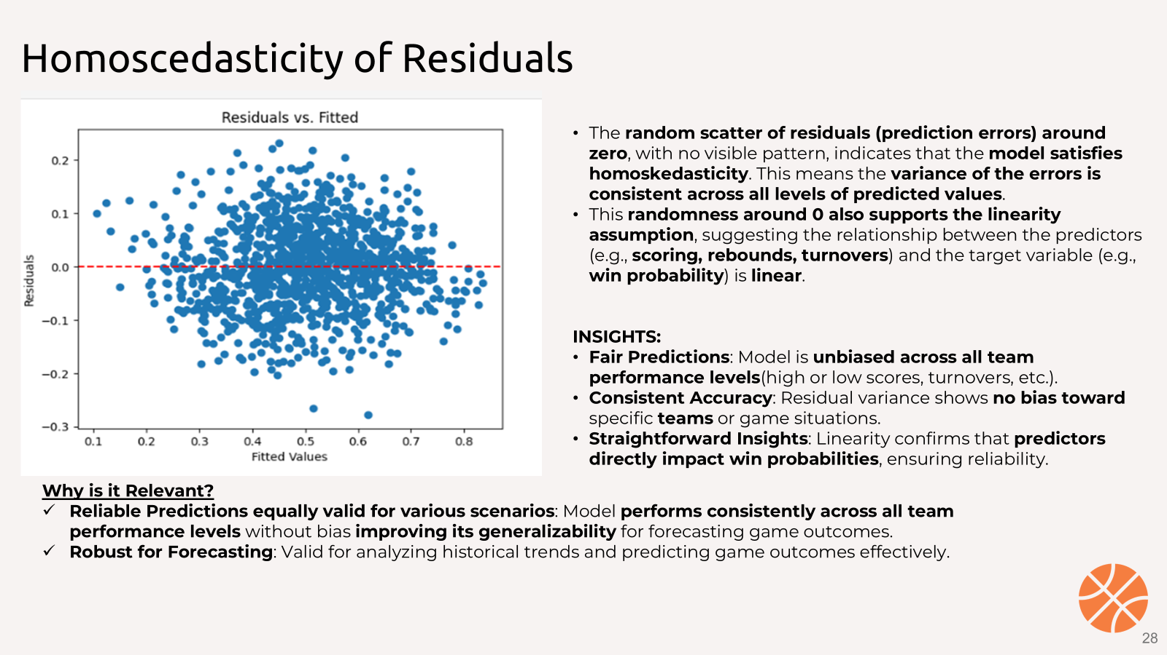
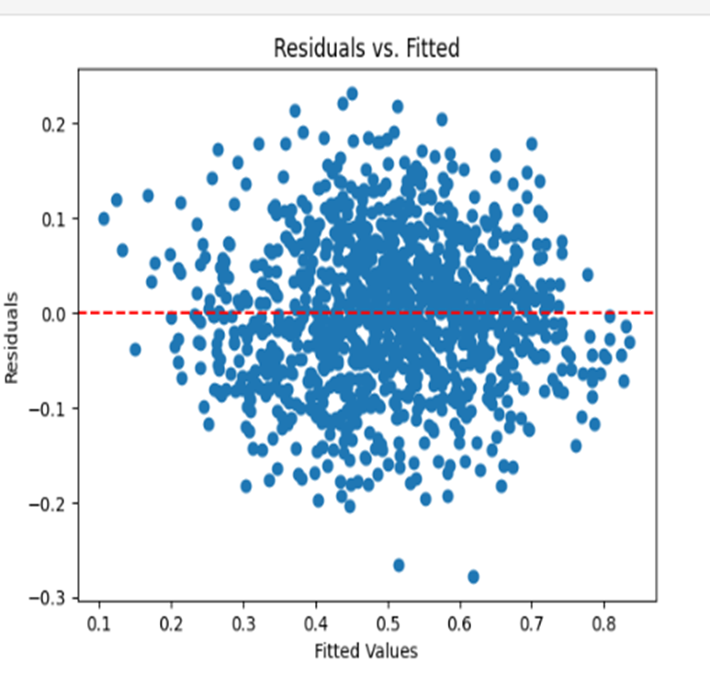
Homoscedasticity of Residuals
Since the residuals show a random scatter with no obvious structure, it suggests that the variance of the residuals is constant across the range of fitted values, which supports the assumption of homoscedasticity.
The plot also gives insight into whether the relationship between the independent variables and the dependent variable is linear. Since the residuals are randomly scattered around 0, with no systematic pattern, it supports the assumption of linearity, as well.

Slide 9
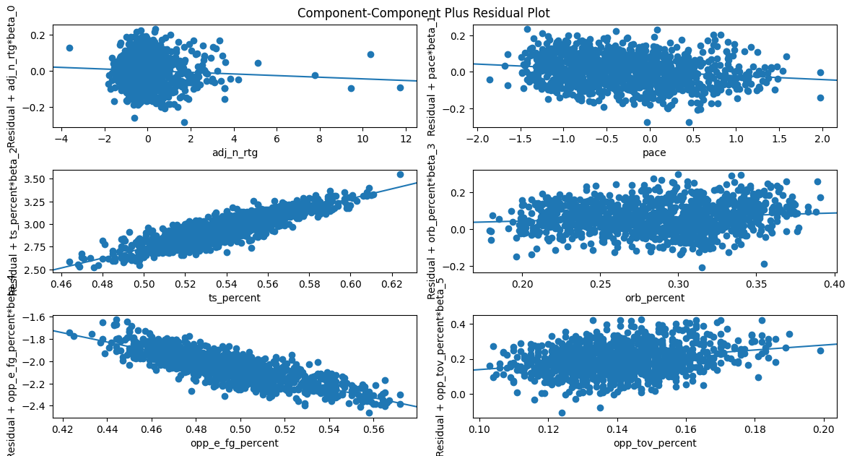
Linearity
Since the residuals are randomly scattered around 0, with no systematic pattern, it supports the assumption of linearity of each of the independent variables with the response/dependent variable. The plot also gives insight into whether the relationship between each independent variable and the dependent variable is linear.
Strong Predictors: Adjusted net rating, true shooting percentage, and opponent effective field goal percentage strongly correlate with game win probability and require no transformations.
Potential Non-linearity: Variables like pace and offensive rebounding percentage may benefit from transformations (e.g., log or polynomial terms) to improve accuracy.
By testing Interaction Terms, we can uncover hidden relationships that improve predictive power:
Pace × True Shooting %: Reveals how shooting efficiency varies in high-tempo games.
Opponent eFG% × Adjusted Net Rating: Highlights defensive impact on opponent shooting.

Slide 10
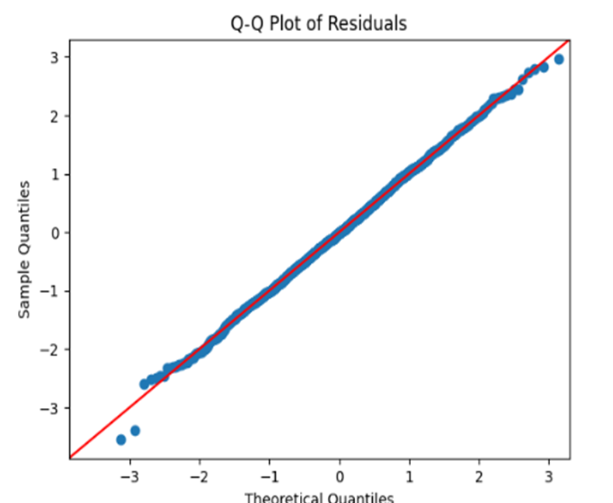
Normality of Residuals
Since the points lie close to the straight line,usually with a slope of 1, implying that the quantiles of the residuals are consistent with the quantiles of a normal distribution. Therefore, we can conclude that the residuals are normally distributed.
Shapiro-Wilk Test
Used to test the null hypothesis that the data follows a normal distribution
Statistic = 0.99908
this value is very close to 1 which suggests that the data is normally distributed.
p-value = 0.84366
Since the p-value is greater than 0.05, we fail to reject the null hypothesis. This suggests that the residuals from the model are normally distributed.

Slide 11
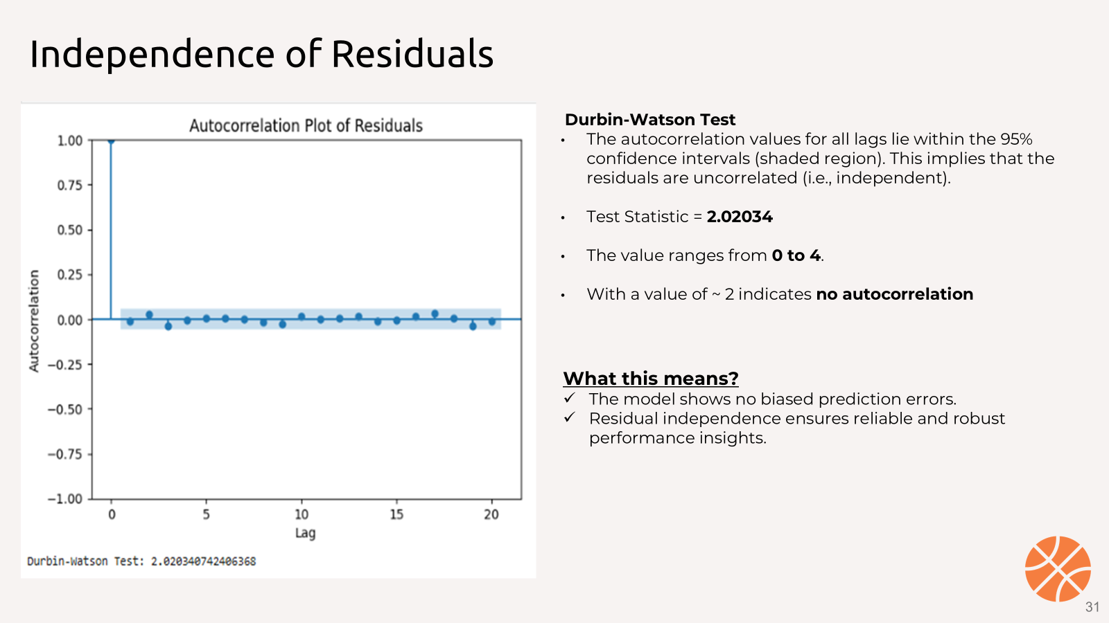
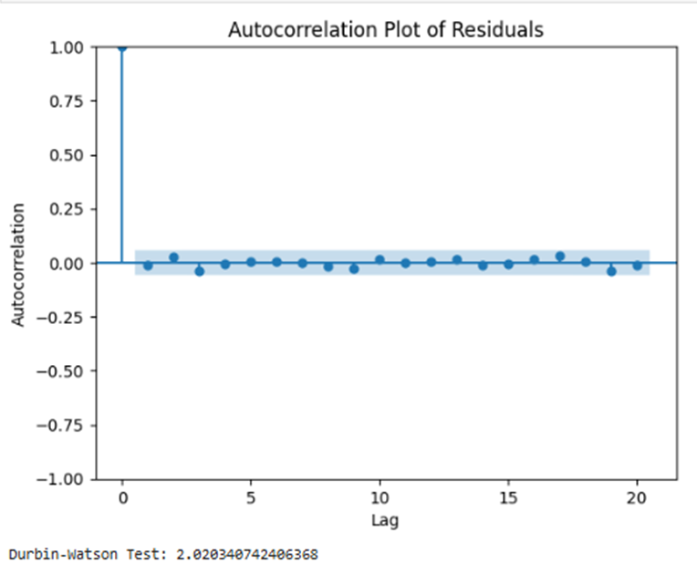
Independence of Residuals
Durbin-Watson Test
The autocorrelation values for all lags lie within the 95% confidence intervals (shaded region). This implies that the residuals are uncorrelated (i.e., independent).
Test Statistic = 2.02034
The value ranges from 0 to 4.
With a value of ~ 2 indicates no autocorrelation
What this means? The model shows no biased prediction errors.
Residual independence ensures reliable and robust performance insights.
Notes:
Interpreting the value:
A value close to 2 suggests that there is no autocorrelation in the residuals.
A value significantly less than 2 suggests positive autocorrelation (residuals are not independent).
A value significantly greater than 2 suggests negative autocorrelation.

Slide 12
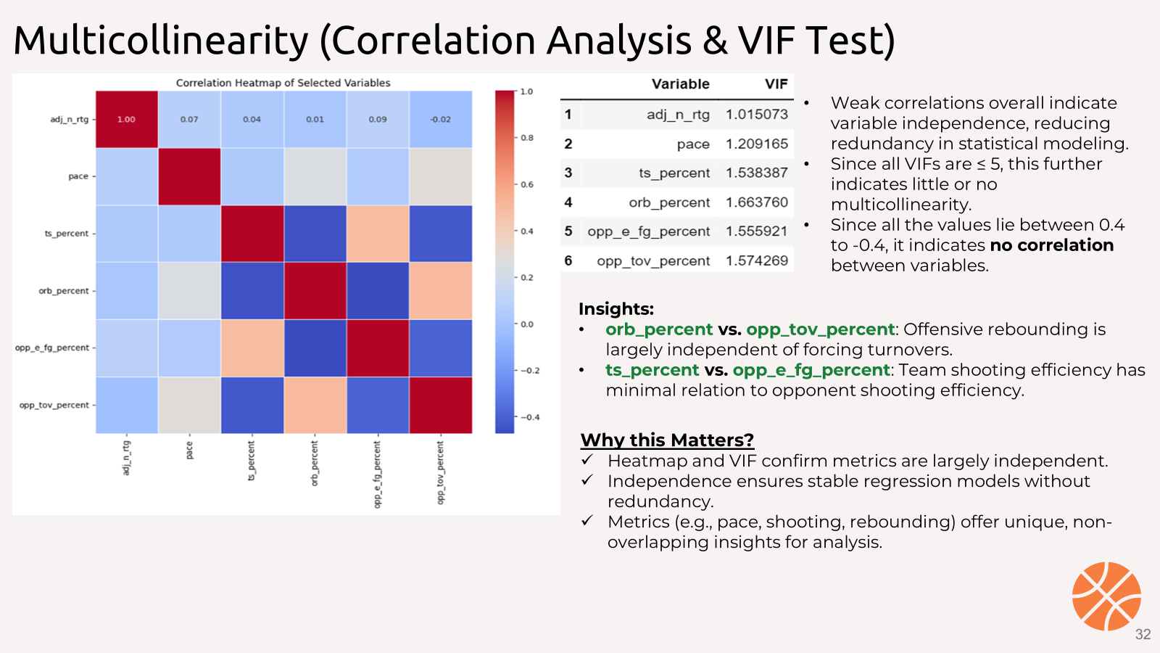
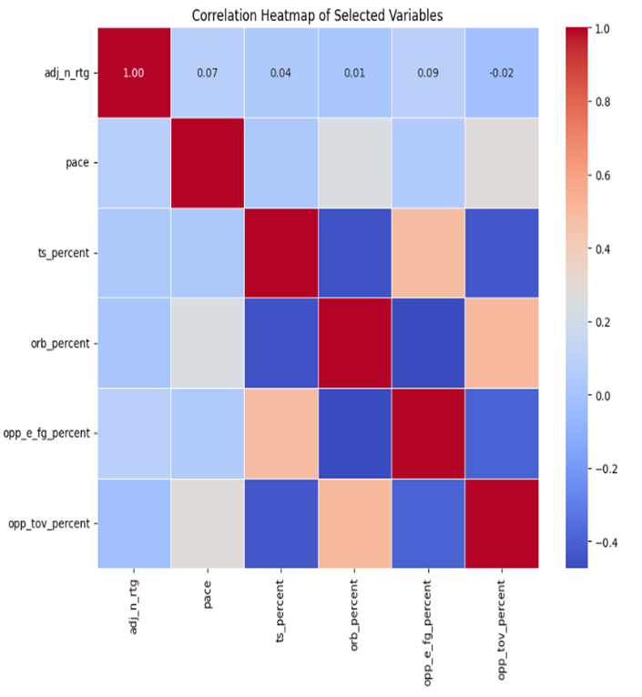
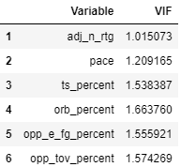
Multicollinearity (Correlation Analysis & VIF Test)
Since all the values lie between 0.4 to -0.4, it indicates no correlation between variables.
orb_percent vs. opp_tov_percent: Offensive rebounding is largely independent of forcing turnovers.
ts_percent vs. opp_e_fg_percent: Team shooting efficiency has minimal relation to opponent shooting efficiency.
Weak correlations overall indicate variable independence, reducing redundancy in statistical modeling.
Since all VIFs are ≤ 5, this further indicates little or no multicollinearity.
Why this Matters?
Heatmap and VIF confirm metrics are largely independent.
Independence ensures stable regression models without redundancy.
Metrics (e.g., pace, shooting, rebounding) offer unique, non-overlapping insights for analysis.
Notes:
Interpretation of VIF Values:
VIF ≤ 5: Indicates little or no multicollinearity. This is generally acceptable.
5 < VIF ≤ 10: Moderate multicollinearity. It's still manageable but may lead to unreliable estimates.
VIF > 10: Indicates high multicollinearity, which could cause issues with model stability and prediction accuracy.

Slide 13
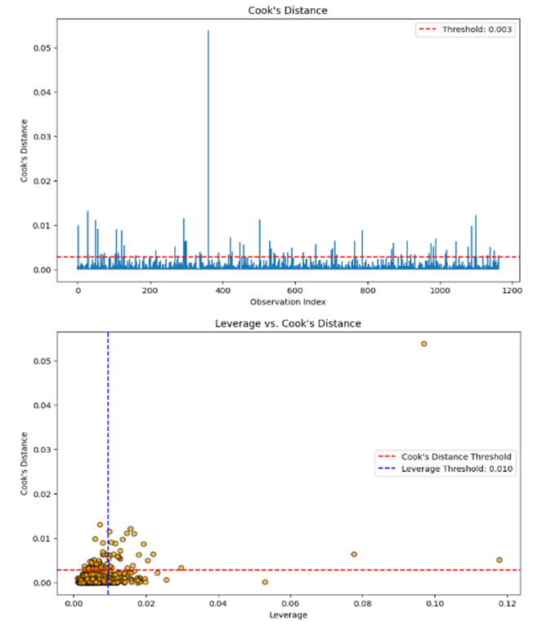



Outliers
Observation
Most observations have low influence on the regression model. One point (~index 400) significantly exceeds the Cook's distance threshold (0.003), indicating it is highly influential and worth investigating.
Most points have low leverage and low influence. One observation (top-right) has both high leverage and high Cook's distance, making it a high-leverage outlier that could disproportionately affect the model.
Insights
Outliers like extreme performances (e.g., unusually high points, exceptional shooting, or turnovers), can skew model predictions. Addressing such outliers ensures more accurate predictions for MVP-level performance and team success.

Slide 14
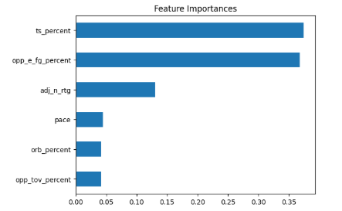


Feature Importance
High importance of ts_percent suggests that efficient scoring is a major factor in success.
High importance of opp_e_fg_percent here indicates that limiting opponents' shooting efficiency is critical for winning games.
This graph indicates the variables which are most relevant to the OLS regression model (in the order of importance). We can see that True Shooting Percentage(ts_percent) and Opponent Effective Field Goal Percentage(opp_e_fg_percent) have the highest importance scores.

Slide 15
More Sophisticated Model Perform Better
OLS Regression
Random Forest Regressor
XGBoost Regressor
Mean Squared Error: 0.005
R² Score: 0.789
Mean Squared Error: 0.01
R² Score: 0.723
Mean Squared Error: 0.006
R² Score: 0.772

Slide 16
Future Work
Experiment with deep learning models (feed-forward neural networks or recurrent neural networks)
Combine physical metrics and game workload data to predict injury risks for players.
Exploration of Neural Networks
Injury Risk Prediction
Expanding the Dataset
Clustering
We can take into consideration the external factor and include variables like ticket sales, fan engagement, or media coverage to assess broader performance influences.
Group players or teams by similar performance profiles

Slide 17
Appendix

Slide 18

Efficiently Selecting Key Variables for Predicting Team Wins
Exclude Outcome-Driven Metrics: Avoid metrics like playoffs or points per game, which directly depend on wins to prevent data leakage.
Check Multicollinearity: Exclude highly correlated variables, e.g., ts_percent and e_fg_percent, to avoid redundancy and ensure model clarity.
Focus on Performance & Efficiency: Prioritize variables like adj_n_rtg, pace, and orb_percent that directly influence team efficiency and performance.
Test Relationships with Wins: Use correlation and VIF to select predictors that have strong, measurable impacts on team wins.
Excluded Variables:
Multicollinearity: Variables like ts_percent, e_fg_percent, and f_tr overlap, causing redundancy.
Predictive Power: Metrics like opp_drb_percent and opp_ft_fga don't add unique value, as adj_n_rtg covers offensive/defensive efficiency.
Irrelevance: Arena and attend were excluded as they don't directly impact win predictions.
Complexity: Excess variables risk overfitting without improving model performance.

